Slide 1
Acquired Immunodeficiency Syndrome
(AIDS)
Professor Nizar Abuharfeil
Jordan University of Science and Technology

Slide 2
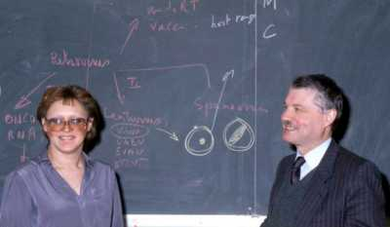
Barré-Sinoussi and Montagnier in 1983
Noble prize 2008
Barré-Sinoussi and Montagnier in 1983,

Slide 3
Acquired Immunodeficiency Syndrome (AIDS)
History
  1981: First reports of “Acquired Immuno-deficiency Syndrome” in Los Angeles.
  1983: Virus first isolated in France (LAV).
  1984: Virus isolated in the U.S. (called HTLV-III and AIDS-Related Virus
  1986: Consensus name Human Immunodeficiency Virus (HIV-1).
  2009: AIDS patients 35 millions
  2012: AIDS patients 35.3 millions
  2014: AIDS patients 36.9 millions
  2018: Global situation :Since the beginning of the epidemic, 75 million people have been infected with the HIV virus and about 32 million people have died of HIV. Globally, 37.9 million people were living with HIV at the end of 2018.
  2020 37.7 million (1.5 million newly infected in 2020)
  2022 Every day, 4000 people—including 1100 young people (aged 15 to 24 years)—become infected with HIV

Slide 4
GLOBAL HIV STATISTICS
38.0 million people globally were living with HIV in 2019.
75.7 million people have become infected with HIV since the start of the epidemic (end 2019).
32.7 million people have died from AIDS-related illnesses since the start of the epidemic (end 2019).
In 2019, around 1.7 million people were newly infected with HIV, compared to 2.8 million people in 1998.

Slide 5
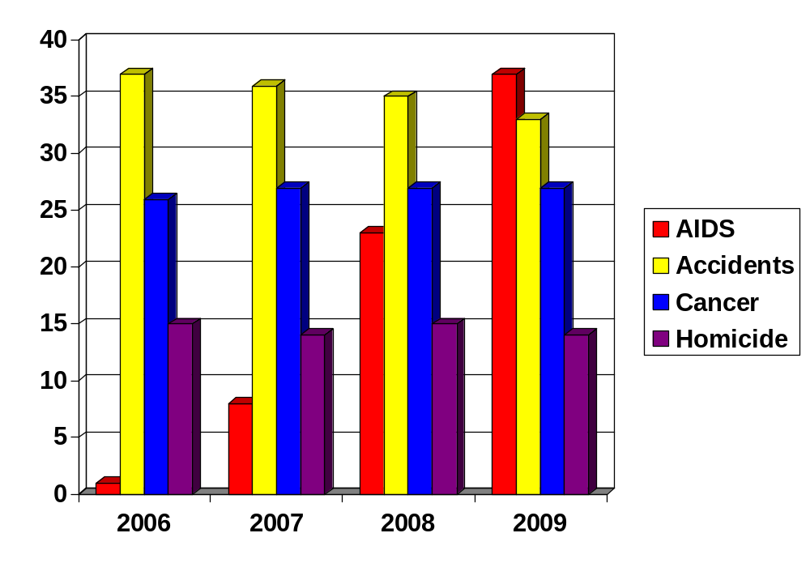
AIDS: A Leading Cause of Death Among People Aged 25-44 years in U.S.
Deaths per 100,000 people aged 25-44 years

Slide 6
Transmission of AIDS (Worldwide)
1. Sexual contact with infected individual
Sexual contact is the most frequent mode of transmission, either between heterosexual couples or between homosexual male partners.
the lining of the rectum is thin, delicate and easily damaged, which can give the virus direct access to the bloodstream. The anal canal is lined by a mucous membrane, which is a thin layer of moist tissue. Vaginal is less risky for getting HIV than receptive anal sex.
2. Blood Transfusions
3. Sharing of unsterilized needles by IV drug. HIV can remain infectious in a used infected needle for 6 weeks . With the advent of routine lab screening blood transfusion and sharing needles account for a very small portion of HIV infections.

Slide 7
4. Mother to Infant (Perinatal)
Human milk from HIV-infected transmitter and non-transmitter mothers was shown to prevent HIV infection in 85% of orally exposed mice, whereas the entire control group was infected .
HIV is not spread by:
Air or water.
Mosquitoes, ticks or other insects.
Saliva, tears, or sweat that is not mixed with the blood of a person with HIV.
Shaking hands

Slide 8
No gay gene
A. does not run in families
B. Gays with aging become normal
C. The findings, which were published on 29 August in Science and are based on the genomes of nearly 500,000 people, although sexual preferences have a genetic component, no single gene has a large effect on sexual behaviors (A. Ganna et al. Science 365, eaat7693; 2019).
There is no ‘gay gene’,” says lead study author Andrea Ganna, a geneticist at the Broad Institute of MIT and Harvard in Cambridge, Massachusetts.
Genetic studies: The 'Gay Gene' Is A Myth ' Say Scientists

Slide 9
The HIV:
HIV is spherical in shape, 1/10,000 mm diameter .
contains two copies of the RNA genome. Each copy of HIV-1 RNA genome has ∼9173 nucleotides that comprise 9 genes and encode 15 viral proteins.
The viral envelope
The viral envelope is composed of:
a. two layers of fatty molecules , taken from the membrane of a human cell.
b. Embedded proteins from the host cell, as well as a complex HIV protein known as Env: gp120 cap & gp41 stem molecules
The viral core
made up of 2,000 copies of the viral capsid protein, p24. That surrounds two ssRNA, includes three enzymes carry out later steps in the virus's life cycle: reverse transcriptase, integrase, and protease.
p17, or the HIV matrix protein, lies between the viral core and the viral envelope

Slide 10
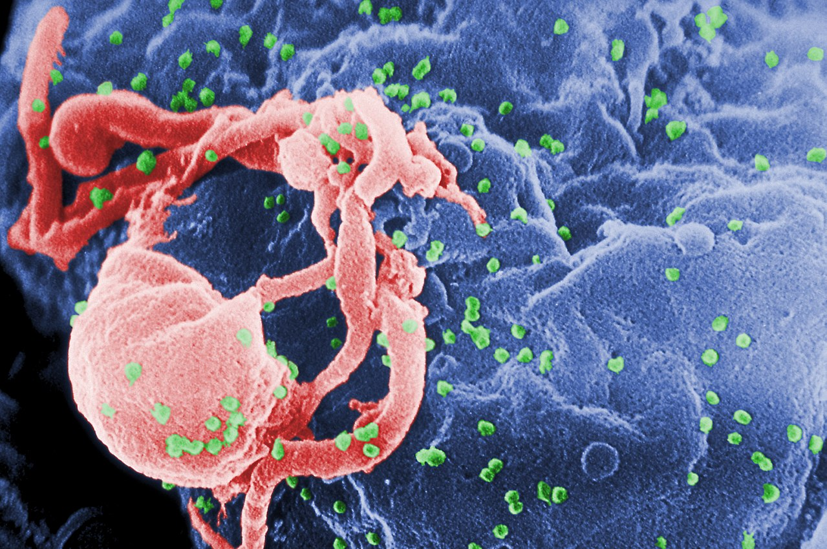
Scanning electron micrograph of HIV-1 (in green) budding from cultured lymphocyte. Multiple round bumps on cell surface represent sites of assembly and budding of virions.

Slide 11
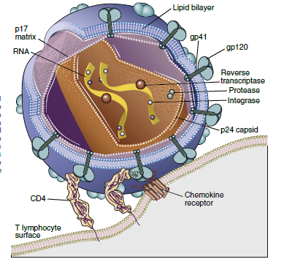

Slide 12
The genes of HIV
3 structural genes (gag, pol, and env).
env gene codes for a protein called gp160 that is broken down by a viral enzyme to form gp120 and gp41
gag codes for core and matrix P17 and capsid p24 proteins
pol codes for reverse transcriptase, protease, ribonuclease and integrase.
HIV has six regulatory genes (tat, rev, nef, vif, vpr, and vpu) that contain information needed to produce proteins that control the ability of HIV to infect a cell, produce new copies of virus, or cause disease.
The ends of each strand of HIV RNA contain an RNA sequence called the long terminal repeat (LTR). control production of new viruses

Slide 13
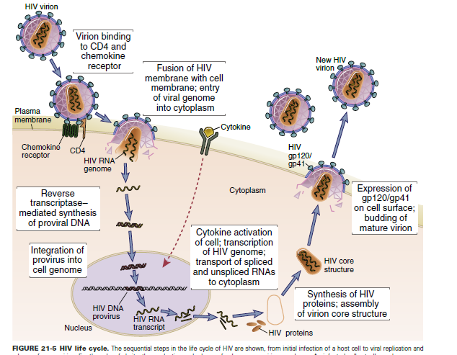

Slide 14
Acute Infection
Acute HIV infection is a condition that can develop as early as 2-4 weeks after someone contracts HIV. It’s the initial stage of HIV, and it lasts until the body has created Abs against the virus.
During this initial stage, the virus is multiplying at a rapid rate. Unlike other viruses, which the body’s immune system can normally fight off, HIV can’t be eliminated by the immune system. Over a long time, the virus attacks and destroys immune cells, leaving the immune system unable to fight off other diseases and infections.
Acute HIV is contagious. However, most people with acute HIV infection don’t even know they’ve contracted the virus as the initial symptoms resolve on their own or may be mistaken for another illness such as the flu..

Slide 15
HIV tropism: CD4+ T-cells (T-tropic) using CXCR4. Macrophage (M-tropic) strains of HIV-1, use CCR5 for entry.
Acute infection is characterized by infection of memory CD4+ T cells in mucosal lymphoid tissues and death of many infected cells.
Because the mucosal tissues are the largest reservoir of T cells in the body and the major site of residence of memory T cells, this local loss is reflected in considerable depletion of lymphocytes
The transition from the acute phase to the chronic phase of infection is accompanied by dissemination of the virus, viremia, and the development of host immune responses

Slide 16
The viremia allows the virus to disseminate throughout the body and to infect helper T cells, macrophages, and dendritic cells in peripheral lymphoid tissues.
Dendritic cells in epithelia at sites of virus entry capture the virus and then migrate into the lymph nodes and pass it to CD4+ cells (within days)
Infection and death of many CD4+ including memory cells in mucosal lymphoid tissue.
Graded decline in CD4+, Reverse ratio CD4/CD8=1/2
Infected and Uninfected cells are also lysed
As the HIV infection spreads, the adaptive immune system mounts both humoral and CMI directed at viral Ags

Slide 17
Chronic Infection
Chronic, phase of the disease, lymph nodes and the spleen are sites of continuous HIV replication and cell destruction
During this period of the disease, the immune system remains competent at handling most infections with opportunistic microbes, and few or no clinical manifestations of the HIV infection are present (Asymptomatic, may lasts 15 years)
At this stage, up to 10% of CD4+ T cells in lymphoid organs may be infected, but the number of circulating CD4+ T cells that are infected at any one time may be less than 0.1% of the total CD4+ T cells in an individual.

Slide 18
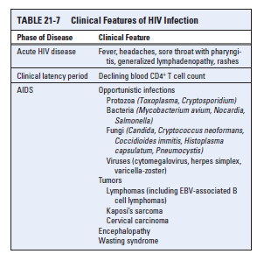
AIDS crises

Slide 19
Killing of activated Infected T cells
1. Direct effect of CD4+ T cells infection: A major cause of the loss of in HIV-infected individuals. If the virus infects an activated and thus permissive cell (i.e., 5% of the total CD4 T cells), productive infection ensues, and the cell dies from a silent caspase-3-mediated apoptosis
2. Increased plasma membrane permeability: The process of virus production, with expression of gp41 in the plasma membrane and budding of viral particles, may lead to increased plasma membrane permeability and the influx of lethal amounts of calcium, which induces apoptosis, or osmotic lysis of the cell caused by the influx of water.
3. Deletion of infected CD4+ T cells by Ag specific CD8+ cytotoxic T cells.

Slide 20
Death of Uninfected activated T cells
1. Chronic activation of the T cells may predispose the cells to apoptosis; chronic activation of uninfected cells by the infections that are common in patients infected with HIV and also by cytokines produced in response to these infections. the molecular pathway involved in this type of activation-induced cell death is not yet defined.
2. Binding of gp120 to newly synthesized intracellular CD4 may interfere with normal protein processing in the ER and block cell surface expression of CD4, making the cells incapable of responding to antigenic stimulation.
3. Uninfected cells are also lysed: gp120 protein will be released and bound to T cells to become foreign and become susceptible to CTL

Slide 21
Mac
the quantity of macrophage-associated HIV exceeds T cell–associated virus in most tissues from patients with AIDS, including the brain and lung
Because macrophages can be infected but are not generally killed by HIV, they may become a reservoir for the virus.
phagocytosis of other infected cells or Fc receptor–mediated endocytosis of Ab-coated HIV virions (ADCC).

Slide 22
Immune Responses to HIV
HIV-specific humoral and CMI evelop after infection but generally provide limited protection
The early response to HIV infection serves to clear most of the virus present in the blood and in circulating T cells
production of antimicrobial peptides (defensins), and activation of NK cells, dendritic cells (particularly plasmacytoid dendritic cells producing IFN α and β, and the complement system.
HIV-specific (CTL) are believed to play a major role in controlling virus levels through the asymptomatic period of HIV infection. The CTLs control infection proved to be ineffective because of the emergence of viral escape mutants (variants with mutated Ags)

Slide 23
Abs
None neutralizing Abs:
The most immunogenic HIV molecules that elicit Ab responses appear to be the envelope glycoproteins, and high titers of anti-gp120 and anti-gp41 Abs are present in most HIV-infected individuals.
Besides other anti-HIV Abs to p24, reverse transcriptase, and gag and pol products.
the early Abs are generally not neutralizing and are thus poor inhibitors of viral infectivity or cytopathic effects.
Neutralizing Abs
Sequencing of Ab H and L chain genes from gp-140–specific B cells in subjects who have been infected with HIV-1 for a few years has revealed the presence of broadly neutralizing Abs.
These Abs bind to a site on a viral protein that the virus cannot afford to mutate, for example, the CD4 binding site of gp140. They are, therefore, effective in clearing the virus. (gp140 is a derivative of gp160, usually created in the lab for vaccine/research purposes.

Slide 24
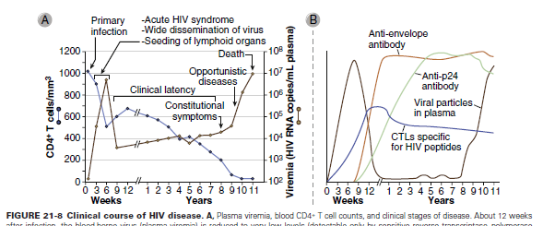

Slide 25
Escape mechanisms
Lack of fidelity of RT and RNA polymerase:
Mutation in gp120 one of the most variable component varies from the same individual (everyday
Mutations are frequent due to HIV's error prone replication and the structural flexibility of the viral envelope (Env).
A region in gp120 called V3 loop is the most antigenically variable: different in the same individual
2. Production of Non-Neutralizing Antibodies
The viral envelope glycoprotein, gp120, is highly variable, and it can quickly mutate to escape recognition by neutralizing antibodies that target specific regions of the protein, thus leading to the production of non-neutralizing antibodies that can bind to gp120 but are unable to block virus entry.
Non-neutralizing antibodies can still play a role in HIV immune evasion. By binding to gp120, they can prevent the recognition of viral epitopes by neutralizing antibodies or T cells, effectively shielding the virus from immune surveillance
2.

Slide 26
3. Covers itself with CD59 and DAF to protect from complement
4. DNA: in provirus is nonantigenic so it hides itself
RNA: the ability of HIV to “camouflage” its RNA within the infected cell using an intracellular methyl transferase enzyme .
5. down regulation of class I and II MHC molecule expression to evade CTLs. The HIV Nef protein inhibits expression of class I and II MHC molecules, mainly by promoting internalization of these molecules.
6. In contrast to activated T cells, Naïve T cells resist HIV infection: Naïve cells have cyt deaminase that mutate HIV and inhibit it. Activated T cells have inactive E. Vif protein bind the E and promote its degradation

Slide 27
7. HIV also evades Ab by coating itself with sugars.
a. By adding asparagine-linked glycosylations during processing of envelope proteins (gp160),
b. the virus is able to produce a 'glycan shield', thus preventing Ab binding.
c. point mutations, insertions, and deletions can alter the positioning of the sugars, resulting in an ever-changing disguise

Slide 28
8. Production of Non-Neutralizing Antibodies
The viral envelope glycoprotein, gp120, is highly variable, and it can quickly mutate to escape recognition by neutralizing antibodies that target specific regions of the protein, thus leading to the production of non-neutralizing antibodies that can bind to gp120 but are unable to block virus entry.
Non-neutralizing antibodies can still play a role in HIV immune evasion. By binding to gp120, they can prevent the recognition of viral epitopes by neutralizing antibodies or T cells, effectively shielding the virus from immune surveillance

Slide 29
9. Induction of Immune Exhaustion
HIV can induce immune exhaustion, which is a state of functional impairment of T cells, at a molecular level by several mechanisms. First, persistent antigen stimulation caused by HIV infection leads to T cell activation and proliferation, eventually leading to T cell exhaustion.
Second, HIV upregulates inhibitory receptors on T cells, such as (PD-1), (CTLA-4)), which negatively regulate T cell activation and function. Third, HIV downregulates the expression of key transcription factors and cytokines, such as the T-Box protein expressed in T cells (T-bet), (IFN-γ) and IL-2, that are necessary for effector T cell function.
These mechanisms collectively contribute to the development of T-cell exhaustion, leading to decreased immune surveillance and clearance of HIV-infected cells

Slide 30
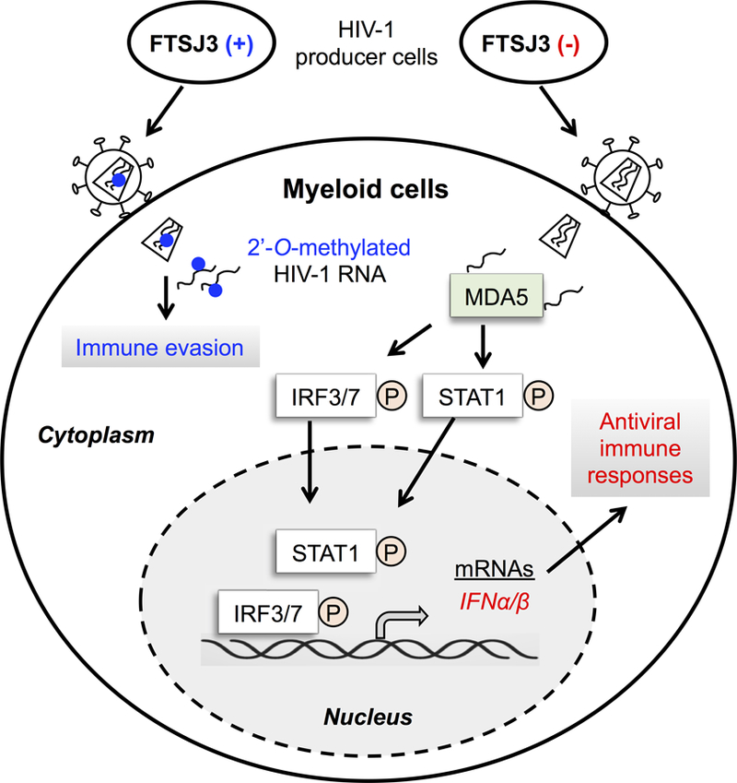
C. Methylation of viral RNA
HIV-1 hijacks cellular proteins to modify its RNA genome and hide from host immune surveillance.
Methylation represents a molecular mark for the host immune system to distinguish it from non-self-RNA of pathogens lacking methylation
Methylation of RNA:
HIV-1 exploits the cellular 2′-O-methyltransferase TSJ3 to methylate viral RNA to escape from innate immune surveillance.
In HIV-1 producer cells, TRBP (not shown) recruits FTSJ3 to HIV-1 RNA and leads to internal 2′-O-methylation (blue dots) of viral RNA. HIV-1 with 2′-O-methylated RNA avoids innate sensing in infected myeloid cells, thereby escaping immune surveillance.

Slide 31
Drugs Against HIV
Today, there are 31 antiretroviral drugs (ARVs) approved by the Food and Drug Administration to treat HIV infection. These treatments do not cure people of HIV or AIDS. Rather, they suppress the virus, even to undetectable levels, but they do not completely eliminate HIV from the body.
Reverse Transcriptase Inhibitors: AZT, ddI, ddC.
Protease Inhibitors: Inhibit the viral proteases. Prevent viral maturation.
Drug Cocktails:
This new triple-drug therapy, commonly referred to as HAART (highly active antiretroviral therapy

Slide 32
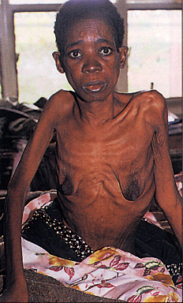
African AIDS patient with slim disease

Slide 33
3. Induction of Immune Exhaustion
HIV can induce immune exhaustion, which is a state of functional impairment of T cells, at a molecular level by several mechanisms. First, persistent antigen stimulation caused by HIV infection leads to T cell activation and proliferation, eventually leading to T cell exhaustion.
Second, HIV upregulates inhibitory receptors on T cells, such as (PD-1), (CTLA-4)), which negatively regulate T cell activation and function. Third, HIV downregulates the expression of key transcription factors and cytokines, such as the T-Box protein expressed in T cells (T-bet), (IFN-γ) and IL-2, that are necessary for effector T cell function.
These mechanisms collectively contribute to the development of T-cell exhaustion, leading to decreased immune surveillance and clearance of HIV-infected cells

Slide 34
4. Destruction of Virus-Specific T Helper Cells
HIV can evade the host immune system by destroying virus-specific Th, which are important for coordinating the immune response against the virus. This occurs at a molecular level through several mechanisms
First, HIV can directly kill infected Th cells by inducing apoptosis or programmed cell death].
Second, HIV-infected cells can also cause the bystander killing of uninfected Th cells through the release of viral proteins, such as Tat, Nef and gp120, which activate apoptosis pathways in nearby cells through several mechanisms such as the upregulation of Fas, FasL and TNFα expression, the reduced expression of Bcl-2 and the activation of p53.
Third, HIV proteins can induce cell death pathways by disrupting the normal functioning of cellular proteins and organelles, such as the mitochondria, which can lead to the death of infected and uninfected Th cells.

Slide 35
5. The Emergence of Antigenic Escape Variants
HIV can evade the host immune system through the emergence of antigenic escape variants, which are viral strains that have mutations in the viral proteins that are recognized by the immune system. Several mechanisms favor this.
First, HIV replicates at a high rate, which results in the generation of a large number of viral particles that can potentially acquire mutations.
Second, the HIV reverse transcriptase, the enzyme responsible for copying the viral genome, is highly error-prone, which increases the likelihood of mutations occurring during replication.
Third, the immune system exerts selective pressure on HIV by targeting specific viral proteins, which can result in the emergence of variants that are less recognizable by the immune system. As a result, HIV can accumulate mutations that allow it to evade immune recognition and continue to replicate. This results in a diverse population of HIV variants that can persist in the host and avoid immune clearance

Slide 36
6. Expression of an Envelope Complex That Minimizes Antibody Access
HIV can evade the host immune system by expressing an envelope complex that minimizes antibody access, which refers to the outer surface of the virus that is recognized by the immune system. The envelope protein of HIV undergoes molecular-level changes through various mechanisms. The envelope protein of HIV is covered in sugar molecules, making it highly glycosylated, and this can prevent antibodies from binding to and neutralizing the virus by shielding vulnerable regions of the envelope protein from antibody recognition .
Another mechanism of evasion is that HIV undergoes rapid mutation of the envelope protein, which allows the virus to constantly evade antibody recognition. By frequently changing the shape of the envelope protein, HIV can avoid recognition by antibodies that were produced against previous strains of the virus. This makes it difficult for the immune system to produce effective antibodies against HIV, which contributes to the ability of the virus to persist in the host

Slide 37
7. Dysregulation of the JAK/STAT Pathway
Interferons are primarily produced and released by host cells such as immune cells (macrophages, dendritic cells, T cells) and non-immune cells (fibroblasts, epithelial cells) in response to viral infections, certain bacterial infections or other immune triggers
Upon detecting viral particles, the host production of interferons creates an antiviral atmosphere which suppresses viral replication through the mechanism of inducing the expression of antiviral proteins and activating immune cells.
However, the virus can uncouple this host defense mechanism by blocking the (JAK)/signal transducer and (STAT) pathway, resulting in the termination of interferon production . Activators of the pathway could potentially help control HIV, but HIV Vpu and Nef disrupt the activation of JAK/STAT by IFN-α stimulation, reducing its induction. HIV also promotes the degradation of Type 1 IFN JAK/STAT pathway components, suppressing the induction of specific Interferon-stimulated genes.

Slide 38
8. Other Factors That Promote HIV Infection
The HIV-1 viral infectivity factor (Vif) is protein found within the HIV-1 virion that plays a crucial role in the survival/invasion of host tissue by HIV. It counteracts the APOBEC3 family of proteins, which are host cellular defense mechanisms that can mutate the genetic material of viruses, including HIV. Vif targets Apolipoprotein B mRNA Editing Catalytic Polypeptide-like (APOBEC3) proteins for degradation, allowing the virus to continue to replicate and spread. Without Vif, HIV is much less able to infect and replicate in host cells. .
Restriction by (SAMHD1) limits the cGAS/STING-dependent innate and adaptive immune responses to HIV-1, and the cGAS and the stimulator of interferon genes (STING) are involved in these responses. SAMDH1 is a restriction factor for HIV-1 infection that has been shown to prevent innate sensing of infection via cGAS/STING, subsequently limiting innate and adaptive responses. Furthermore, a class of NOD-like receptors (NLR), which are primarily associated with the inflammasome, have recently been associated with the production of interferons, which are significant in the fight against viral infections. The NLRX1 subtype of NLR has been reported to appropriate STING to negatively regulate the interferon response, facilitating the replication of HIV-1 and DNA viruse

